Slide 1
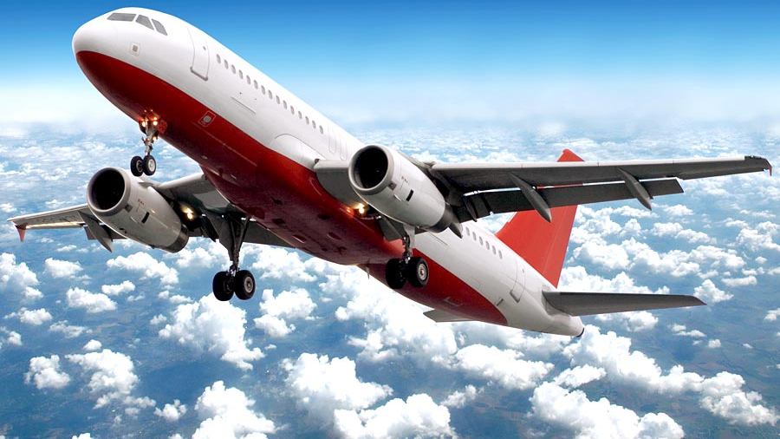
Airline Passenger Satisfaction
by Anthony Tan

Slide 2
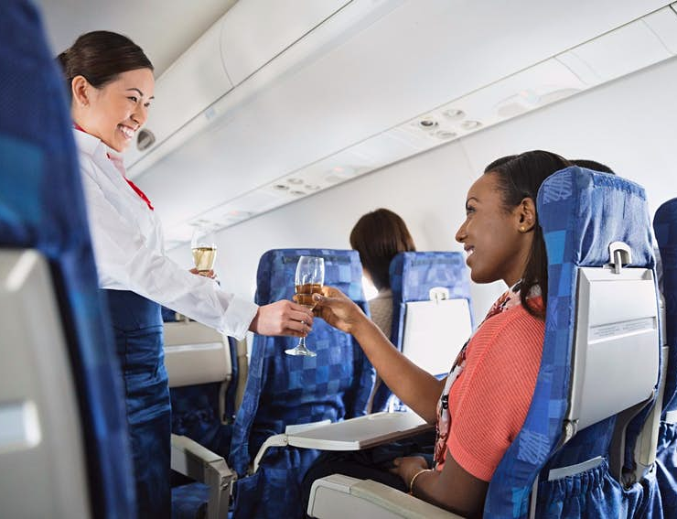
Agenda
Background
Business Question
Data Analysis / Model Evaluation
Recommendations

Slide 3
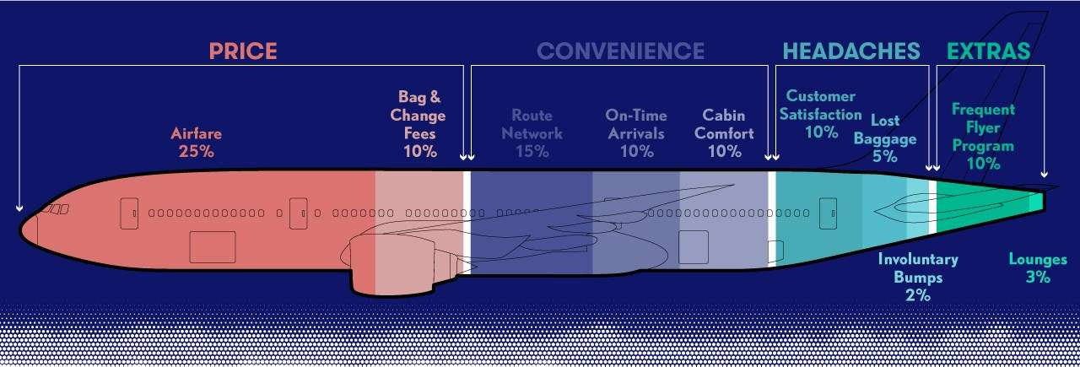
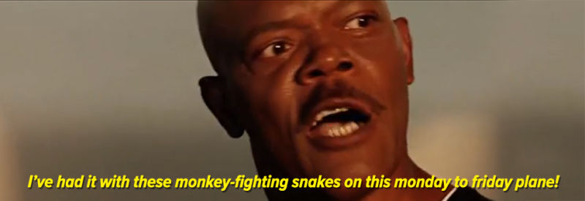
Customer Satisfaction in the Airline Industry
(Source: https://thepointsguy.com/guide/best-and-worst-airlines-2018/ )

Slide 4
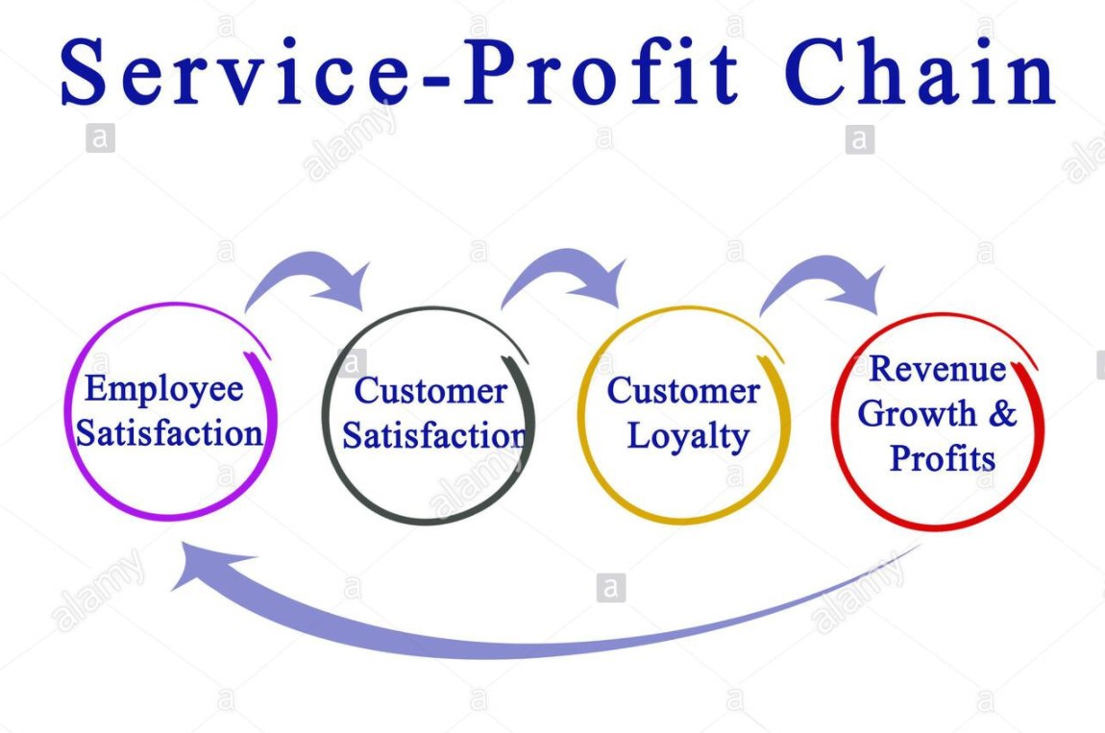
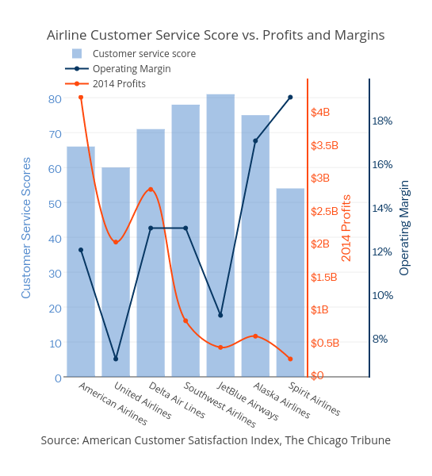
Why is it so important?
(Source: https://workinstitute.com/the-importance-of-the-service-profit-chain-theory/ )

Slide 5


Business Question
Over 60% of 100,000 customers surveyed were dissatisfied
How can we reduce customer dissatisfaction?

Slide 6
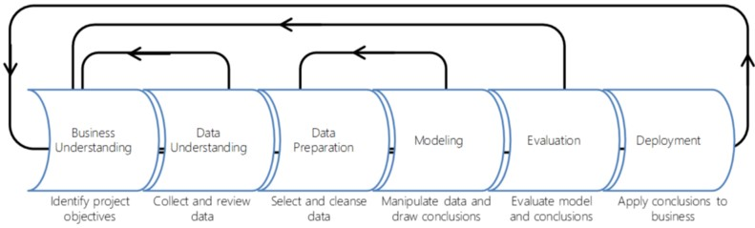
Pipeline

Slide 7
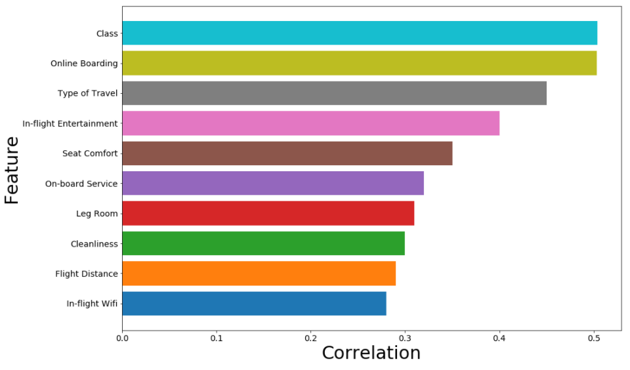
Feature Selection
Survey criteria rated on a scale of 1-5
In-Flight Entertainment and Seat Comfort showed strong relationship to customer satisfaction
Passenger Class and Type of Travel were also strong categorical features
Removed variables with little-to-no correlation (e.g. gender and age)

Slide 8
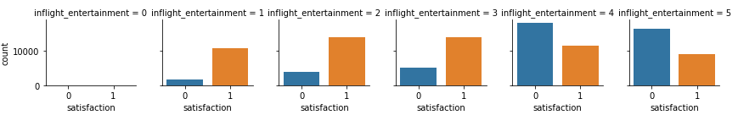
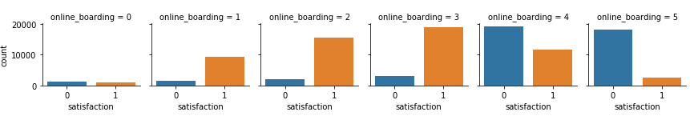
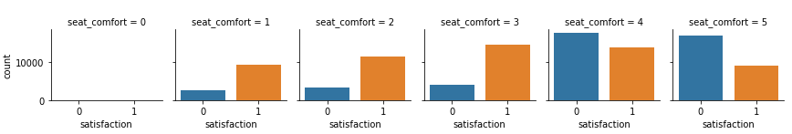
Survey Results

Slide 9
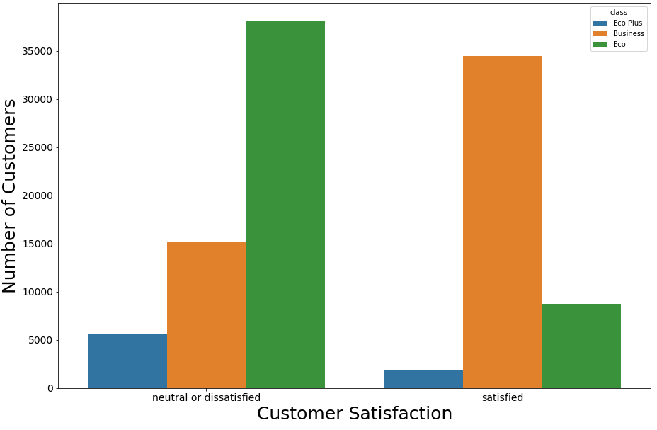
Passenger Class
Business class – over 70% satisfied
Economy class – over 80% dissatisfied

Slide 10
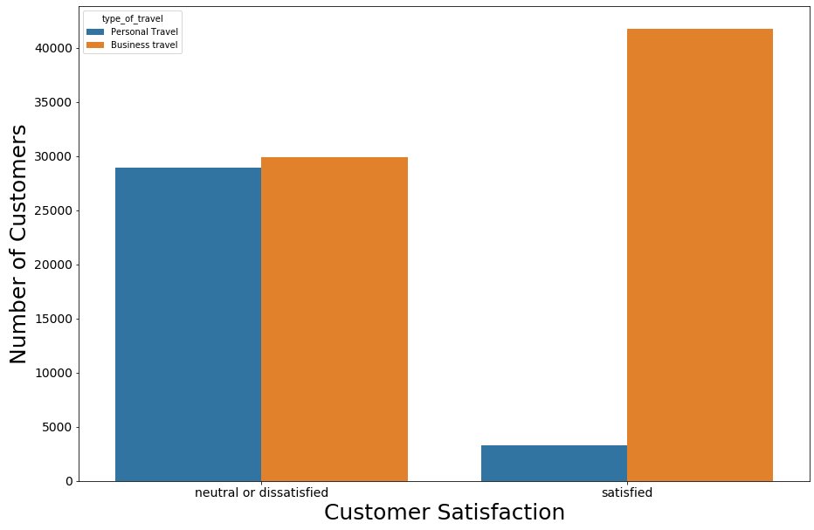
Purpose of Travel
Business Travel: Over 65% was satisfied
Leisure Travel: Only 10% was satisfied

Slide 11
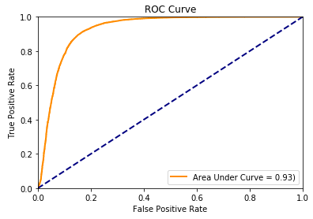
Prediction Model Comparison
 | Logistic Regression | Support Vector Machines | Naïve Bayes
Accuracy | 87% | 51% | 86%
Precision | 88% | 57% | 87%
Recall | 90% | 51% | 90%

Slide 12
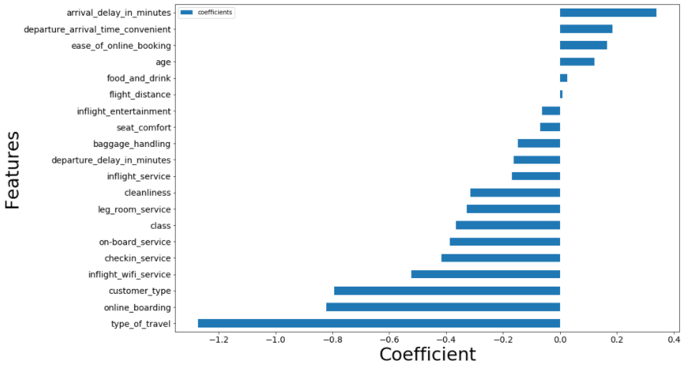
Findings
Flight distance, entertainment, and seat comfort much lower impact than originally hypothesized
Online boarding and wi-fi were stronger than previously assumed

Slide 13

Recommendations
Complimentary in-flight wifi to all passengers of all classes
Improve quality of food and beverage service for leisure market
Research shows that leisure travellers tend to value meal service, while business travellers prefer comfort
(Source: https://www.linkedin.com/pulse/business-leisure-travel-drivers-overall-satisfaction-vikas-mittal )

Slide 14
Summary
Objective
Reduce customer dissatisfaction
Identify which specific areas in the customer experience result in negative critique
Process
Conclusions
Purpose of travel, passenger class, and wi-fi had highest impact on customer feedback
Implement new recommended changes to enhance customer experience
Build prediction model to determine which factors influence the outcome with most accuracy

Slide 15
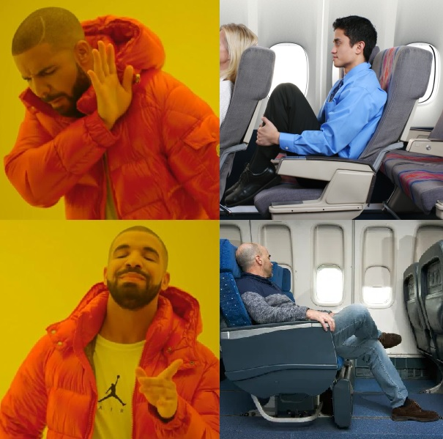
Thank you

